Slide 1


Store Sales Forecasting
Done by:
Hamza Naser
Diaa Alqadi
Dana Ghazal

Slide 2
Problem Definition

Slide 3
Basic question to be resolved
How to increase store sales and attract more store customers during the next 3 months?
Initial situation
Decision makers
Store Manager
Regional Sales Director
Marketing Manager
The store is experiencing sales that are not meeting desired targets or growth expectations. The store operates in a competitive retail environment. Over the next 3 months, achieve a 5% growth in the number of customers.
Decision/success criteria
Constraints
Increase weekly sales by 10% through the establishment of new branches across various regions.
Improve customer engagement and enhance their experience.
Improve marketing and sales strategies.
Budget limitations for opening new branches and for implementing sales improvement strategies.
Compliance with legal and ethical standards in marketing and sales activities.
Project scope
Focus on the 45 stores and on the regions that achieve the largest number of sales.

Slide 4
Problem Structuring

Slide 5
Hypothesis Tree
How various factors affect store sales?
Does holiday impact sales?
Sales are higher during holiday weeks
Non-holiday weeks show regular sales patterns
How does weather affect sales?
Extremely hot or cold temperatures might negatively impact sales
Warmer weather positively influences sales
How does fuel price affect weekly sales?
Higher fuel prices lead to lower sales
Sales patterns change when fuel prices fluctuate
Do markdowns influence weekly sales?
Sales increase significantly during markdown periods
Different markdown types have varying impacts on sales

Slide 6
Deductive Tree
How can we improve store sales?
Store characteristics
Seasonal impact
Markdown optimization
Holiday sales
Create targeted holiday promotions to boost sales
Optimize markdown timing and strategy for higher sales
Account for seasonal patterns to enhance forecasting accuracy
Economic indicators
Consider CPI and unemployment rates for better predictions
Tailor strategies based on store type and size for optimized forecasts

Slide 7
Tasks Identification

Slide 8
1) Data Preprocessing
- Data Gathering
- Data Assessing
- Data Cleaning
- Data Merging
2) Data Visualization
- Univariate
- Bivariate
- Multivariate
3) Hypothesis Testing
4) Feature Extraction
- Date
5) Feature Selection
- mRMR
- RFE
6) Conclusion

Slide 9
1) Data Preprocessing

Slide 10
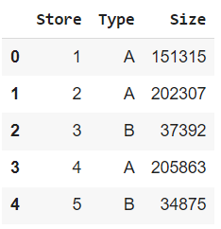
Data Gathering
Our dataset includes 3 tables where provided as .CSV file format that contains information about sales for 45 Walmart stores located in different regions.
Stores Dataset: General informations about each store, 45 rows x 3 columns
Column | Description | Data Type
Store | Stores numbers from 1 to 45 | Categorical
Type | Store type has been provided, there are 3 types A, B, and C | Categorical
Size | Stores size | Numerical

Slide 11
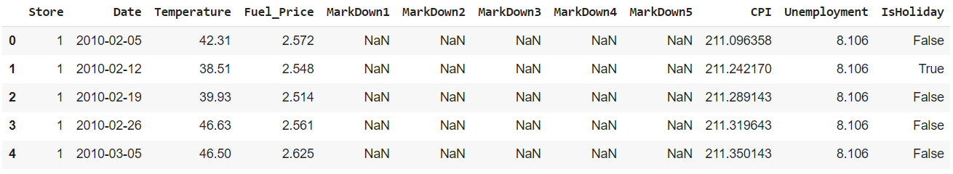
Features Dataset: Records store-specific data for different business weeks, categorized into Regional Information (like Temperature and Unemployment) and Promotional Information (such as Advertising options). 8,190 rows x 12 columns
Column | Description | Data Type
Store | The store number | Categorical
Date | Day of the week | Categorical
Temperature | Average temperature in the region in Fahrenheit | Numerical
Fuel_Price | Cost of fuel in the region in Dollars | Numerical
MarkDown1 | Anonymized data related to promotional markdowns that Walmart is running | Numerical
MarkDown2 | Anonymized data related to promotional markdowns that Walmart is running | Numerical
MarkDown3 | Anonymized data related to promotional markdowns that Walmart is running | Numerical
MarkDown4 | Anonymized data related to promotional markdowns that Walmart is running | Numerical
MarkDown5 | Anonymized data related to promotional markdowns that Walmart is running | Numerical
CPI | The consumer price index | Numerical
Unemployment | The unemployment rate | Numerical
IsHoliday | Whether the week is a special holiday week | Categorical

Slide 12
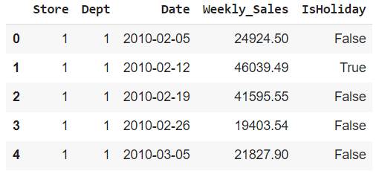
Train Dataset: Weekly Sales for each store/dept, 421,570 rows x 5 columns
Column | Description | Data Type
Store | The store number | Categorical
Dept | The department number | Categorical
Date | Day of the week | Categorical
Weekly_Sales | Sales for the given department in the given store in Dollars | Numerical
IsHoliday | Whether the week is a special holiday week | Categorical

Slide 13
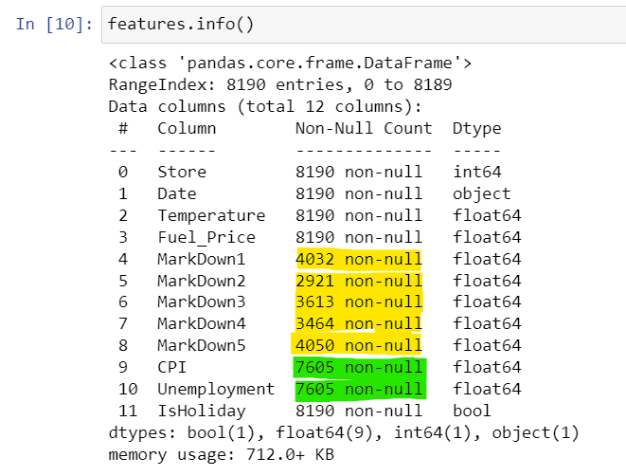
Data Assessing
Checking for NULL Values:
We noticed that features table contains null values in below columns:
The five MarkDown columns (1-5)
CPI and Unemployment columns

Slide 14
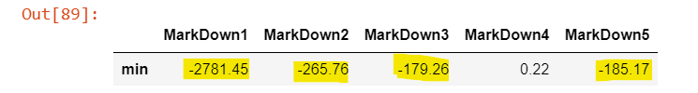

Checking for -ve Values:
We noticed that we got –ve values in features table in Markdown columns (1-3) and 5.
We also got 1285 –ve values in Weekly_Sales column in the train table.

Slide 15
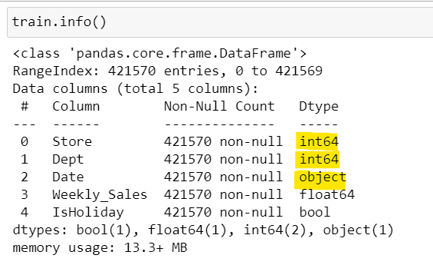
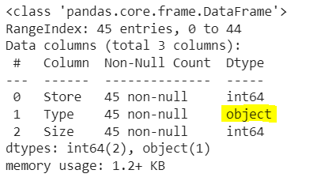
Checking for Data Type:
Data type is wrong for below columns:
Column | Type | Correct Type
Store | int64 | category
Dept | int64 | category
Date | object | datetime64
Type | object | category

Slide 16
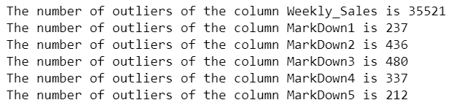
Checking for Outliers:
We got outliers values in six columns as shown below:
- Weekly_Sales
- The five MarkDown columns (1-5)

Slide 17
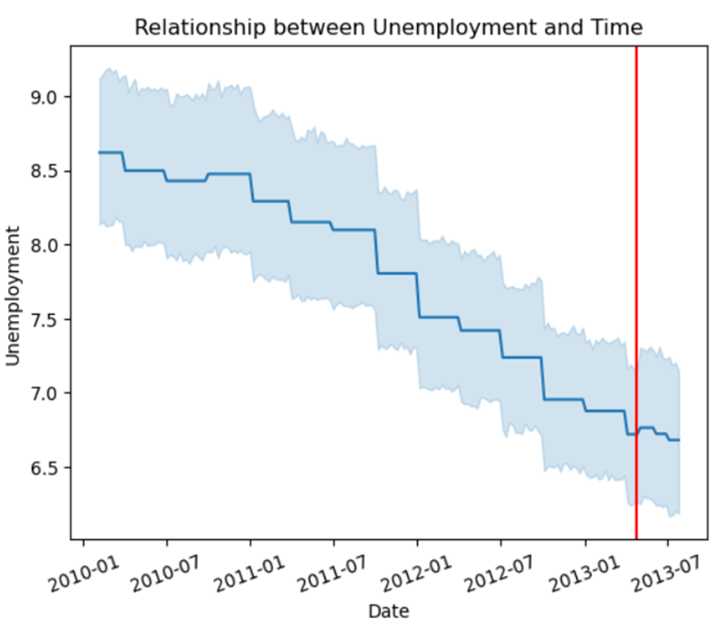
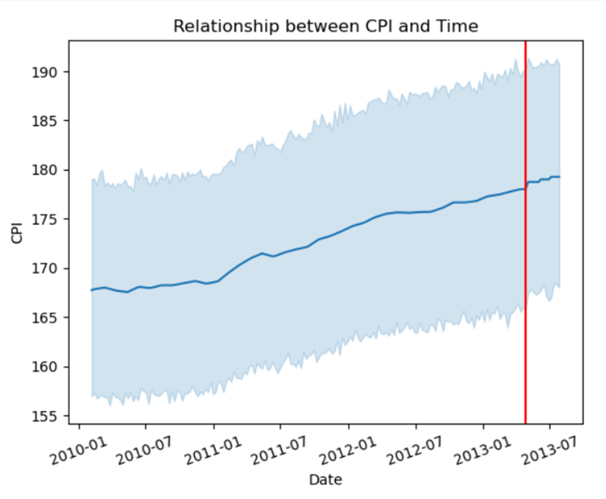
Data Cleaning
Handling Missing Values:
Nulls in markdown columns imply no promotions for those weeks, and we have addressed them by replacing them with zeros.
CPI and Unemployment columns contain nulls influenced by time (Date) and location (Store number). To tackle this, we built a linear regression model to impute and fill nulls in CPI and Unemployment based on time and store.

Slide 18
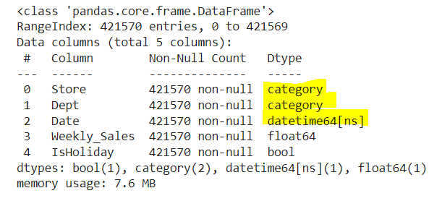
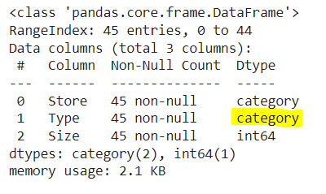
Correct the Data Type:
We have changed the data type in the tables for the column Date to date time, Store to category, Dept to category, and Type to category.

Slide 19
We have dropped rows in the feature table for Markdown columns (1-3) and 5 that have negative values. We also dropped rows in the train table for Weekly_Sales column which contain negative values.
Drop the Negative Values:

Slide 20
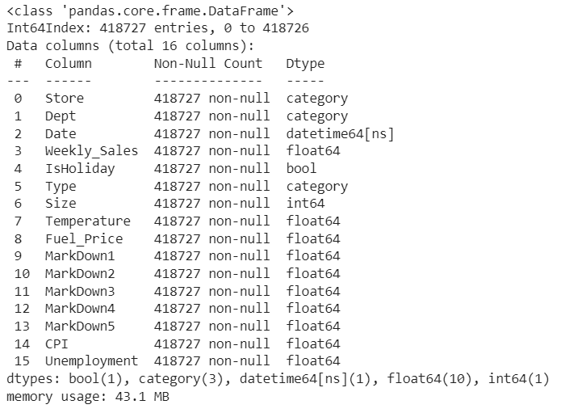
Data Merging
We have merged the three distinct tables, namely the Features table, Stores table, and Train table, into a consolidated and comprehensive master dataset.
This unified dataset will contain a harmonized representation of store-specific information, including regional and promotional details, sales data, and store attributes.

Slide 21
Since we are trying to predict weekly sales its not a wise move to drop outliers since this will affect the model's performance and the ability to predict the sales for out-of-sample data. The same thing applies for Mark Down Promotions.
We converted the Temperature column values from Fahrenheit to Celsius to make it more interpretable.

Slide 22
2) Data Visualization

Slide 23
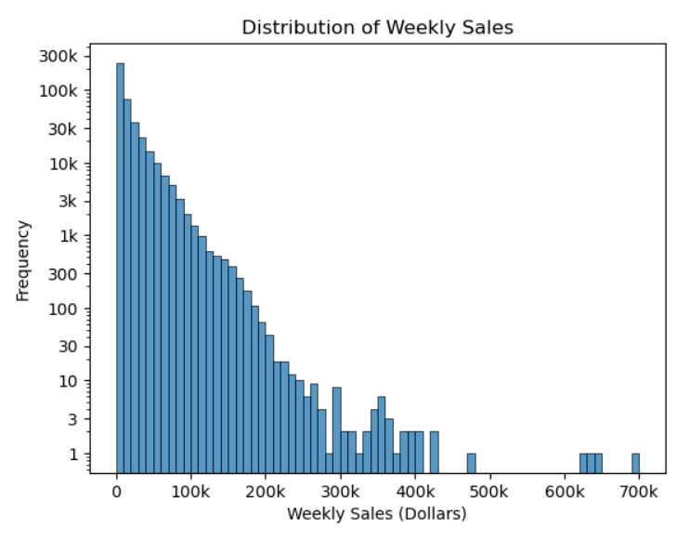
Univariate Visualizations
What is the distribution of weekly sales?
The distribution of weekly sales is highly skewed to the right.
The most common weekly sales are between $0 and $20k.

Slide 24
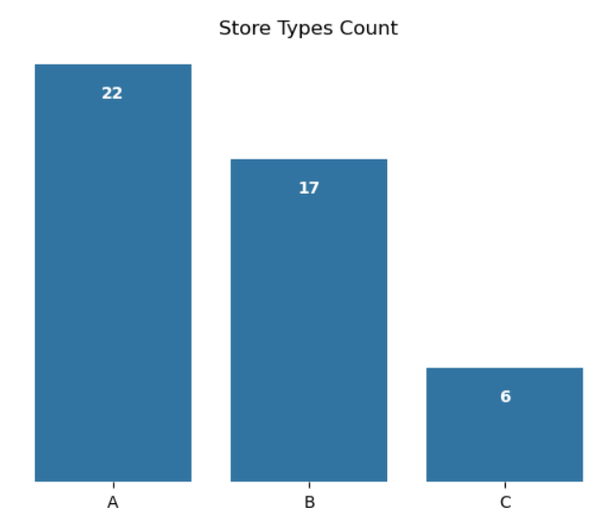
How many distinct store types are present in our dataset?
The dataset appears to have three types of stores, type A being the most popular and type C being the least popular.

Slide 25
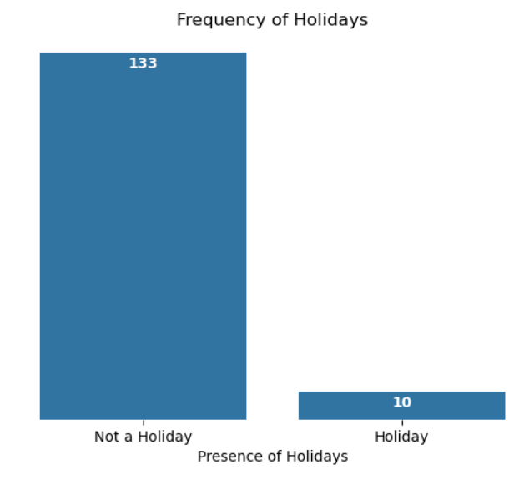
How many holidays are included in the set of unique dates within the dataset?
During the period from Feb 5, 2010, to Oct 26, 2012, a total of 10 weeks featured holidays, while 133 weeks passed without holidays.

Slide 26
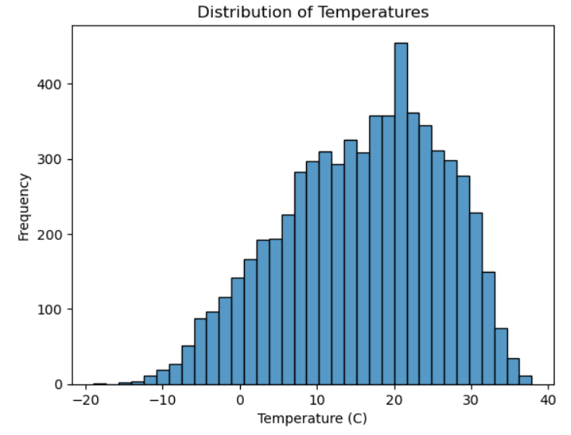
How are the temperatures distributed over the weeks?
The temperature distribution is approximately normal.
The most common temperatures are between 15°C and 25°C.

Slide 27
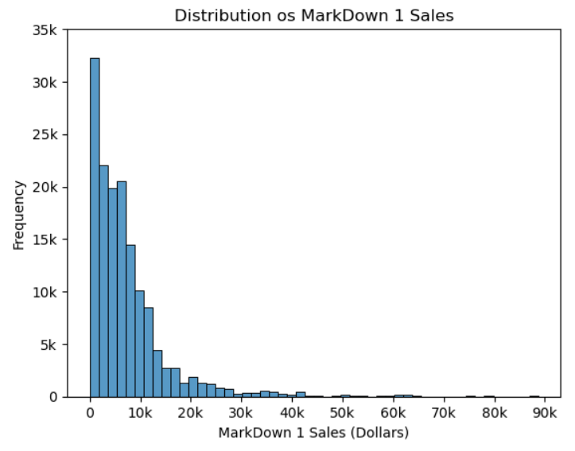
What is the arrangement of sales across Markdown 1?
The distribution of markdown 1 sales is highly skewed to the right.
The most common amount of markdown 1 sales is between $0 and $10k.

Slide 28
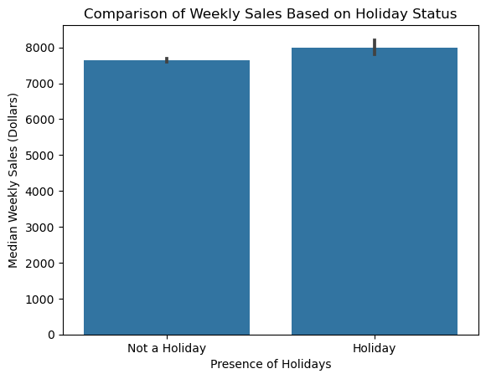
Bivariate Visualizations
Is there a noticeable trend in weekly sales in relation to holiday and non-holiday weeks?
Sales show a minor increase during holiday weeks compared to regular weeks, forming the basis for a hypothesis we aim to test for statistical significance.

Slide 29
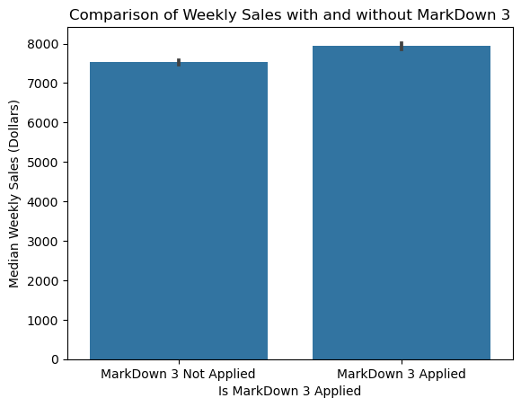
Does the presence of Markdown 3 correlate with observable differences in weekly sales behavior?
Using Markdown 3 leads to higher weekly sales, implying more purchases, but more analysis is needed to confirm this and consider other factors.

Slide 30
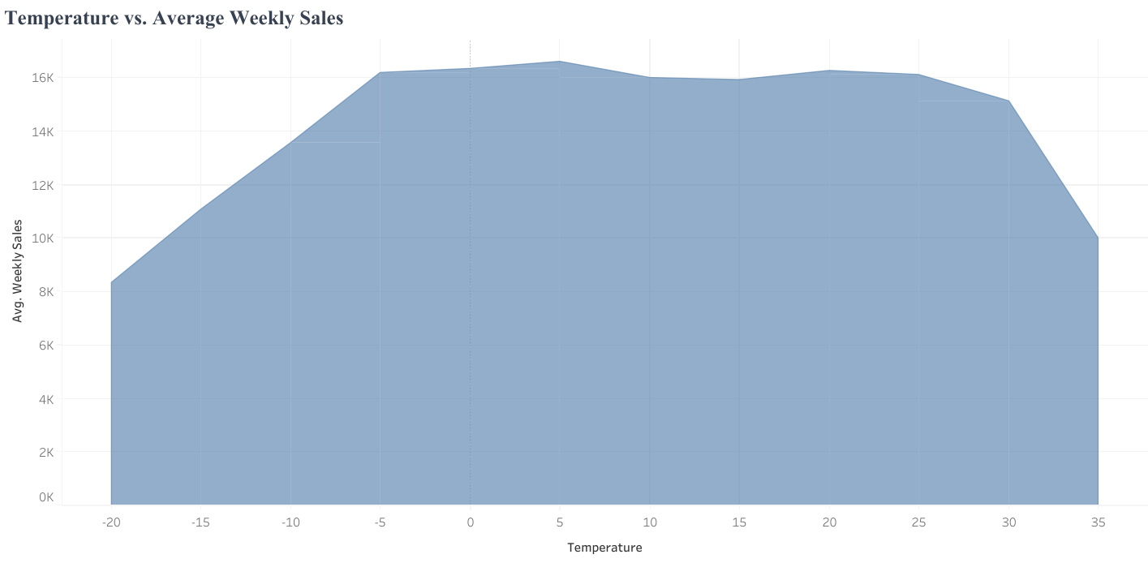
Does the weather conditions affect weekly sales?
Weekly Sales are affected only on extreme high, or extreme low temperatures.

Slide 31
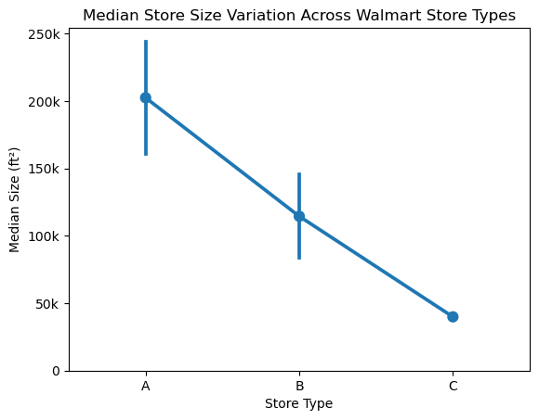
How does the median size of Walmart stores vary across different store types?
Among Walmart store types A, B, and C, type A is the biggest on average and has the most size variation, suggesting a mix of large and small stores with diverse strategies.

Slide 32
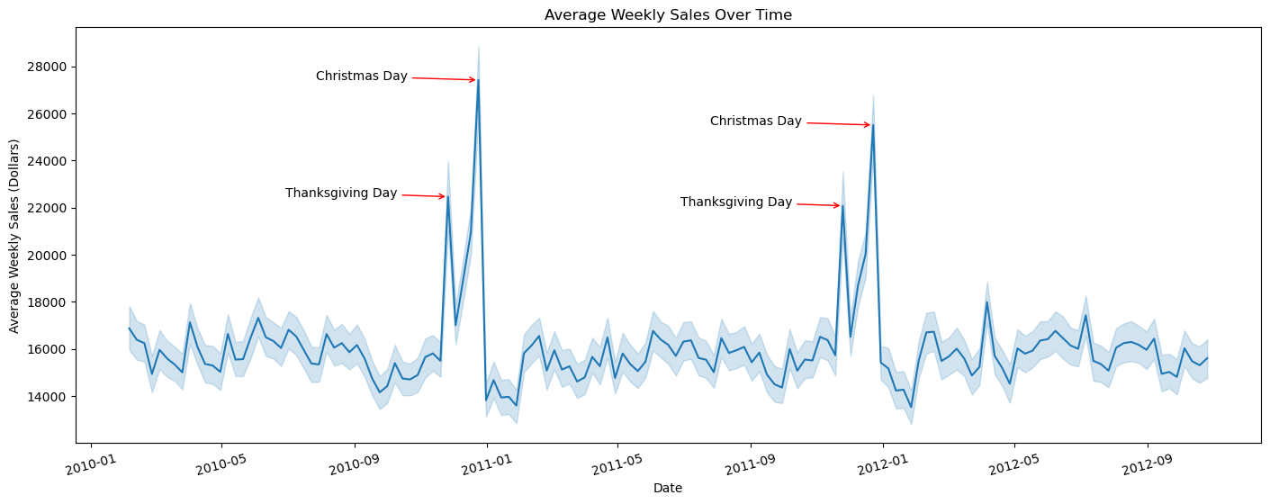
How do holidays like Christmas Day and Thanksgiving Day impact the pattern of average weekly sales over the observed period?
Holidays like Christmas and Thanksgiving have the highest average weekly sales, showing that people spend more during these times.

Slide 33
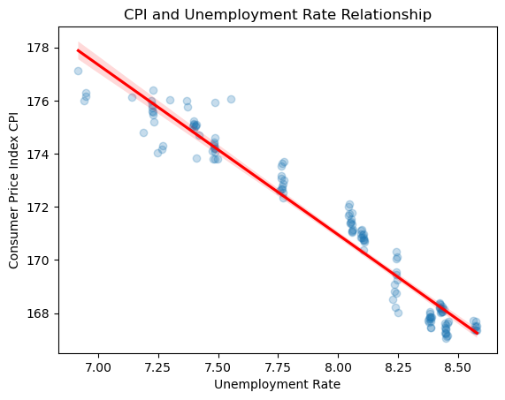
Is there a discernible relationship or correlation between the Consumer Price Index (CPI) and the Unemployment Rate?
1- In economics, when unemployment drops, inflation tends to rise. This is called the Phillips Curve.
2- Consumer Price Index (CPI) up, prices up; CPI down, prices down. High CPI, high inflation; low CPI, low inflation or deflation.

Slide 34
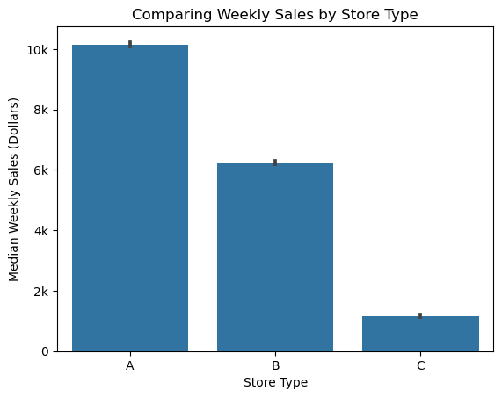
Which store type demonstrates the highest median weekly sales, and how do other types compare?
Store type A has the highest median weekly sales among various types. It consistently outperforms types B and C in terms of weekly sales, indicating its better performance.

Slide 35
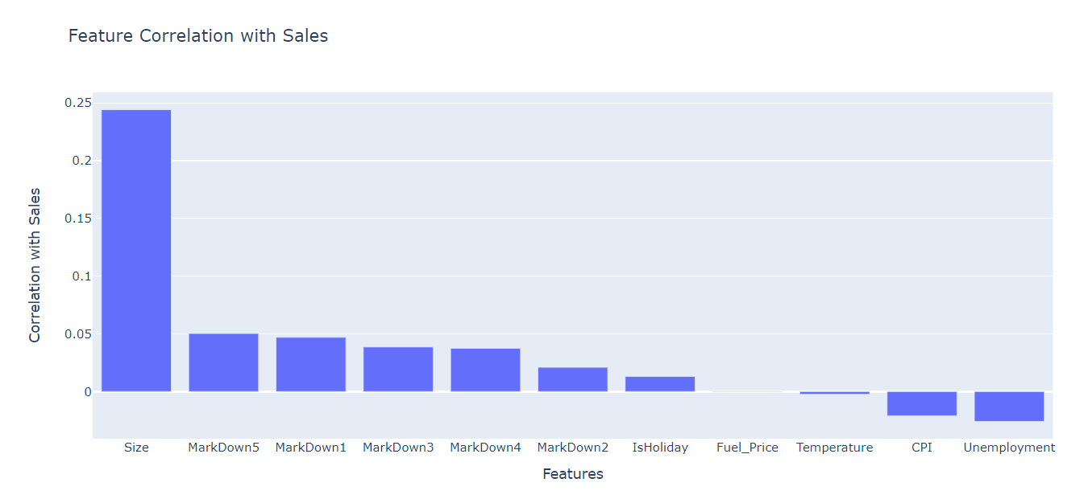
How much other variables correlated with weekly sales?
As shown below, Size is highly correlated with Sales, as larger stores are expected to generate higher sales.
Also, one thing to notice is that fuel price almost no effect on sales based on correlation point of view.

Slide 36
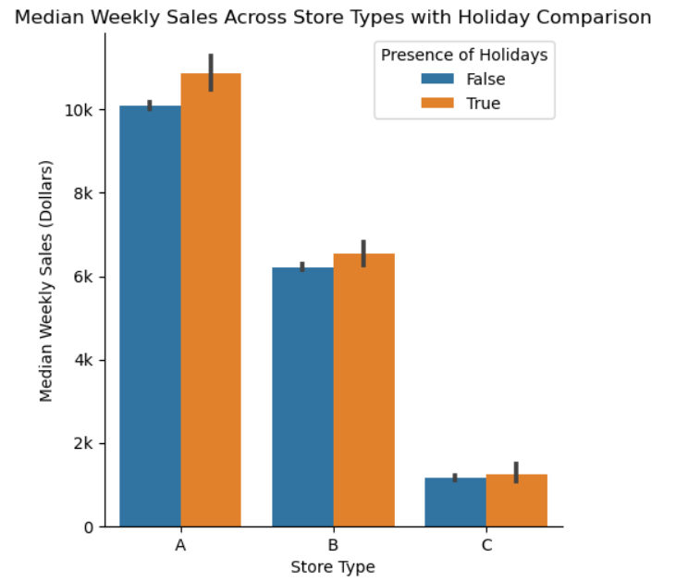
Multivariate Visualizations
How does the average weekly sales of different types of stores differ if the week is a holiday or not?
The bar chart displays median weekly sales across store types, categorized by holiday weeks.
Store type A consistently shows the highest median sales, regardless of holidays.

Slide 37
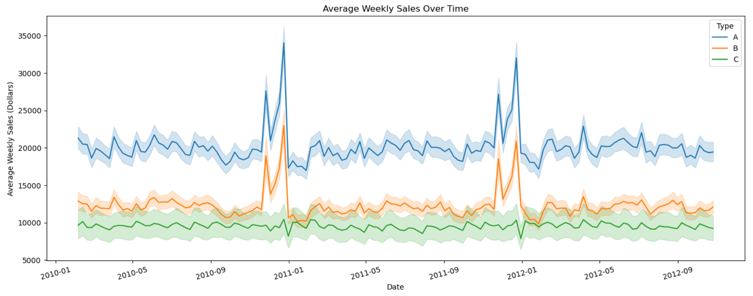
How do the weekly sales patterns of store types A, B, and C compare over the observed time period?
The line plot compares weekly sales trends among different store types. Store A consistently leads in sales, followed by B and C. Holidays show minimal impact on type C stores, possibly due to their product specialization.

Slide 38
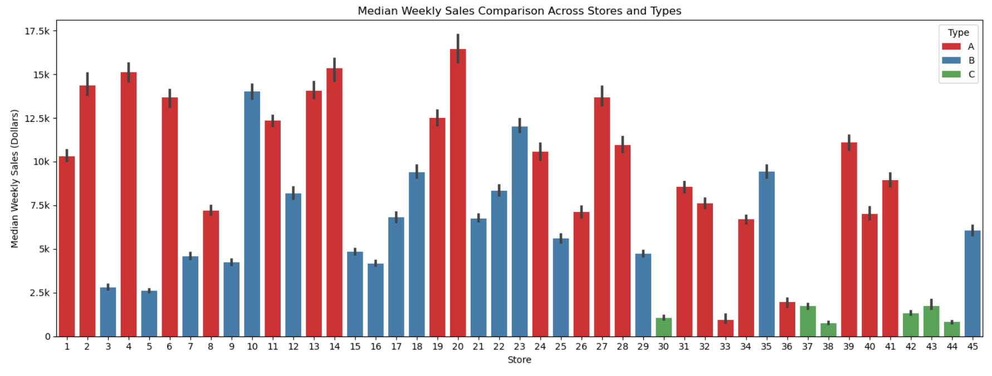
What conclusions can be drawn about the performance of individual stores in relation to their types?
The analysis reveals median weekly sales patterns for store types A, B, and C. Store A consistently leads, potentially due to premium products or effective strategies. Types B and C show lower sales, influenced by varying factors like target audience and offerings.

Slide 39
3) Hypothesis Testing
Holidays affects on Sales
Types affects on Sales (A, B, C)
MarkDowns affects on Sales

Slide 40
Holidays affects on Sales
Hypothesis:
H0: Sales in holidays = Sales in normal days
H1: Sales in holidays > Sales in normal days
P-Value & Conclusion:
Alpha = 0.05
P-value = 1.4e-17 ~= 0
Since P-Value is near Zero, we reject the H0 and conclude that sales in holidays are significantly higher than the sales in normal weeks.

Slide 41

Types affects on Sales (A, B, C)
Hypothesis:
H0: Sales_A = Sales_B = Sales_C
H1: Sales_A > Sales_B > Sales_C
P-Value & Conclusion:
Reject H0 and conclude that Sales is different based on Store’s Type.

Slide 42
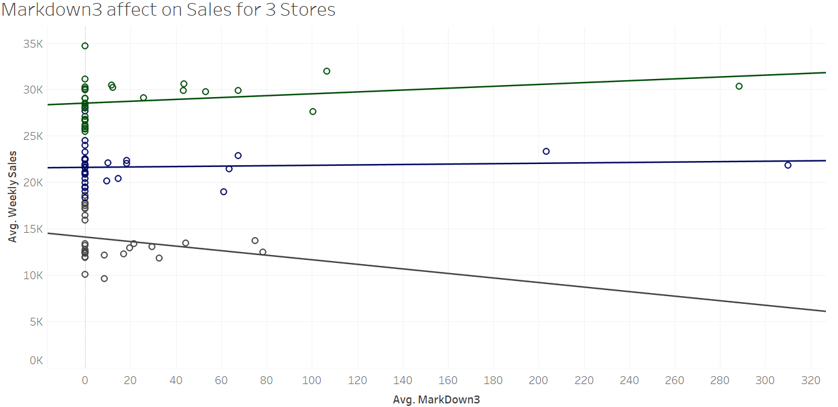
MarkDowns affects on Sales
All Stores
Single Store Level
Hypothesis:
H0: Sales with MarkDowns = Sales without MarkDowns
H1: Sales with MarkDowns > Sales without MarkDowns

Slide 43
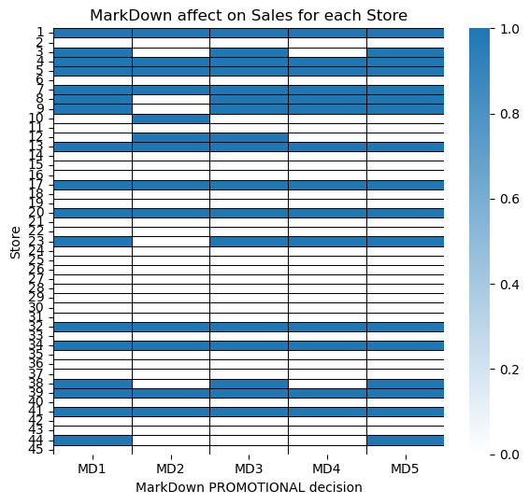

Slide 44
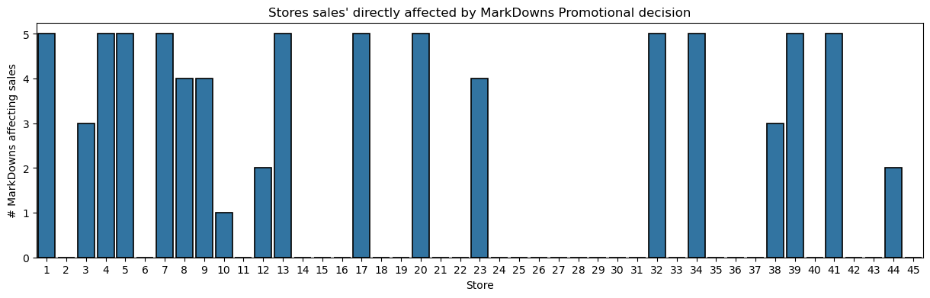
Conclusion
Since P-Values is less than 0.05 for some Stores we reject H0 partially and conclude MarkDown Promotional decisions have direct effect on certain Stores

Slide 45
4) Feature Extraction

Slide 46
Its possible to extract below 2 features out of Weekly Sales Date:
Year
Month
We can extract Year, Month out of Week Date as both have strong relationship in determining the Seasonality Pattern as shown below in time series analysis of sales.

Slide 47
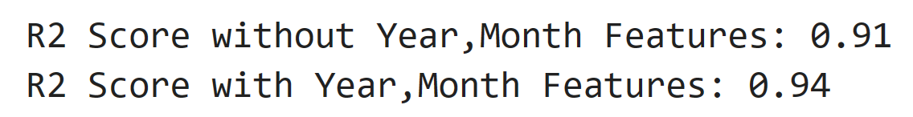
Feature Extraction Result
As expected, model prediction performance have improved by 3% extracting Year, Month out of Sales Week date.

Slide 48
5) Feature Selection

Slide 49
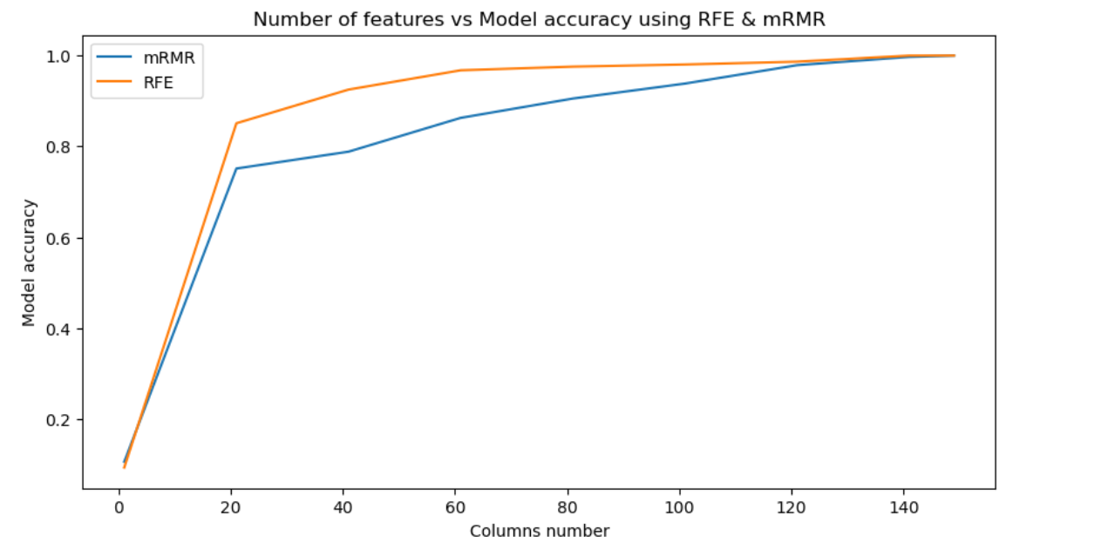
We ran feature selection using mRMR and RFE models with different columns number.
The graph shows that when ever columns number increased the models accuracy will also increase!
As a conclusion, all the features in our model are relevant to the data and will include all of them in our future training model.

Slide 50
6) Conclusion

Slide 51
Open new large branch for Stores with Type A since they have the highest Sales.
Make use of Holidays to boost Sales by applying special events and promotions.
Further investigation how some Stores Sales getting higher with MarkDowns promotions while other Stores not.
Consider Economic Indicators, Climate Change, Seasonality and Store characteristics while predicting Weekly Sales for better control over the Store’s resources.

